Slide 1
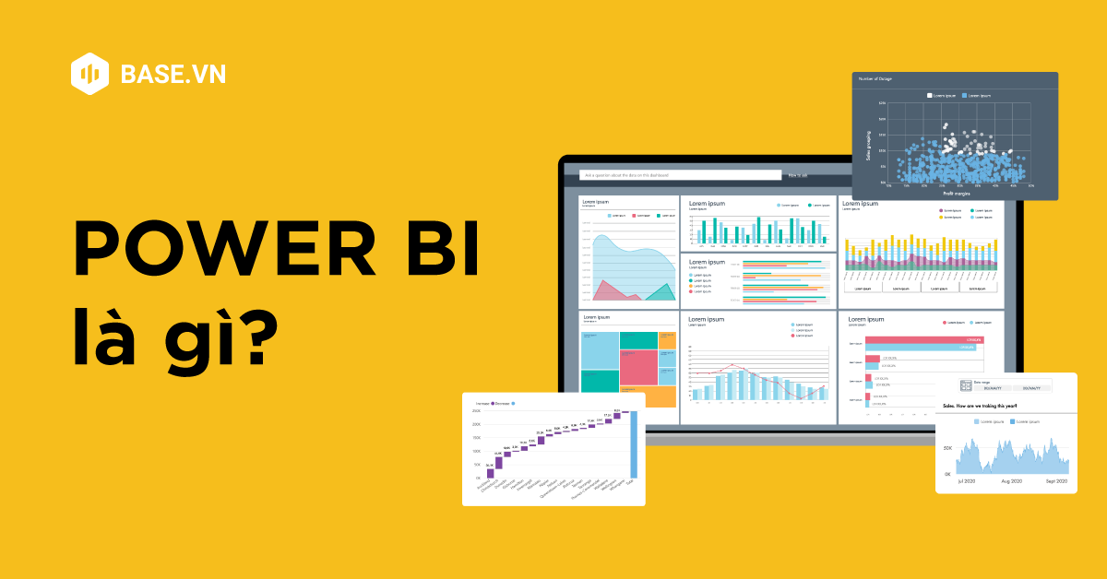
Power BI Dashboard – Sales Analysis
An Interactive Dashboard for Business Insights
By: Ajay Sudhakar Gande
Date: April 2025

Slide 2
Objective & Tools
Objective: To analyze business performance through an interactive dashboard that provides insights into sales, profit, discounting patterns, and regional/customer trends.
Tools & Dataset:
Tool: Power BI
Dataset: Superstore Sales (Kaggle)
Fields: Order Date, Sales, Profit, Region, Segment, Category, Discount

Slide 3
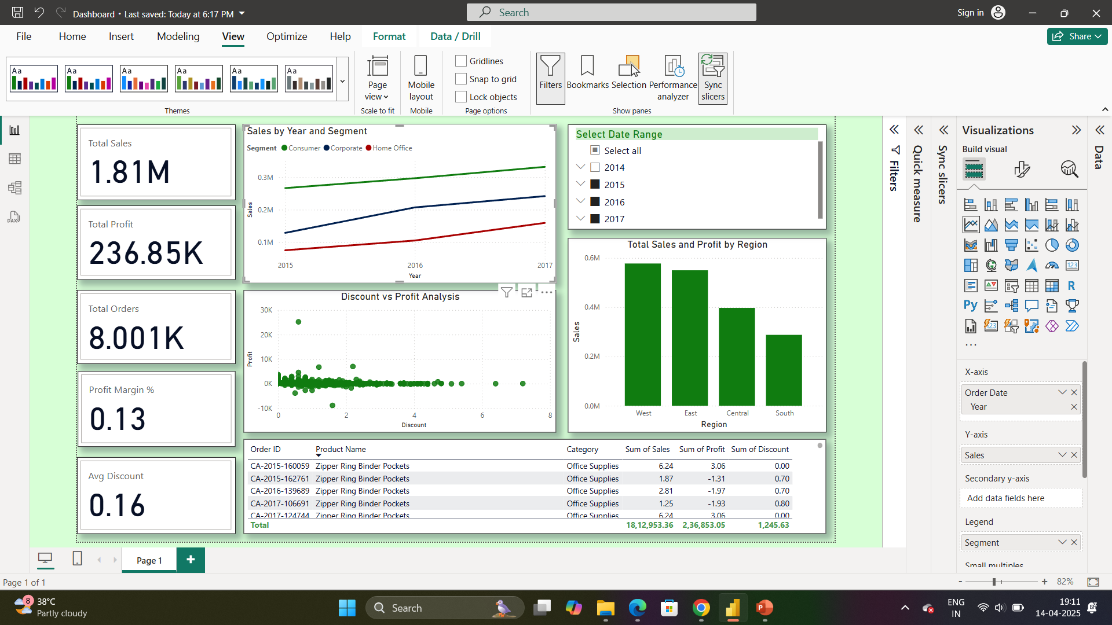
Key Metrics
Total Sales: ₹1.81M
Total Profit: ₹236.85K
Total Orders: 8K+
Profit Margin: 13%
Average Discount: 16%

Slide 4
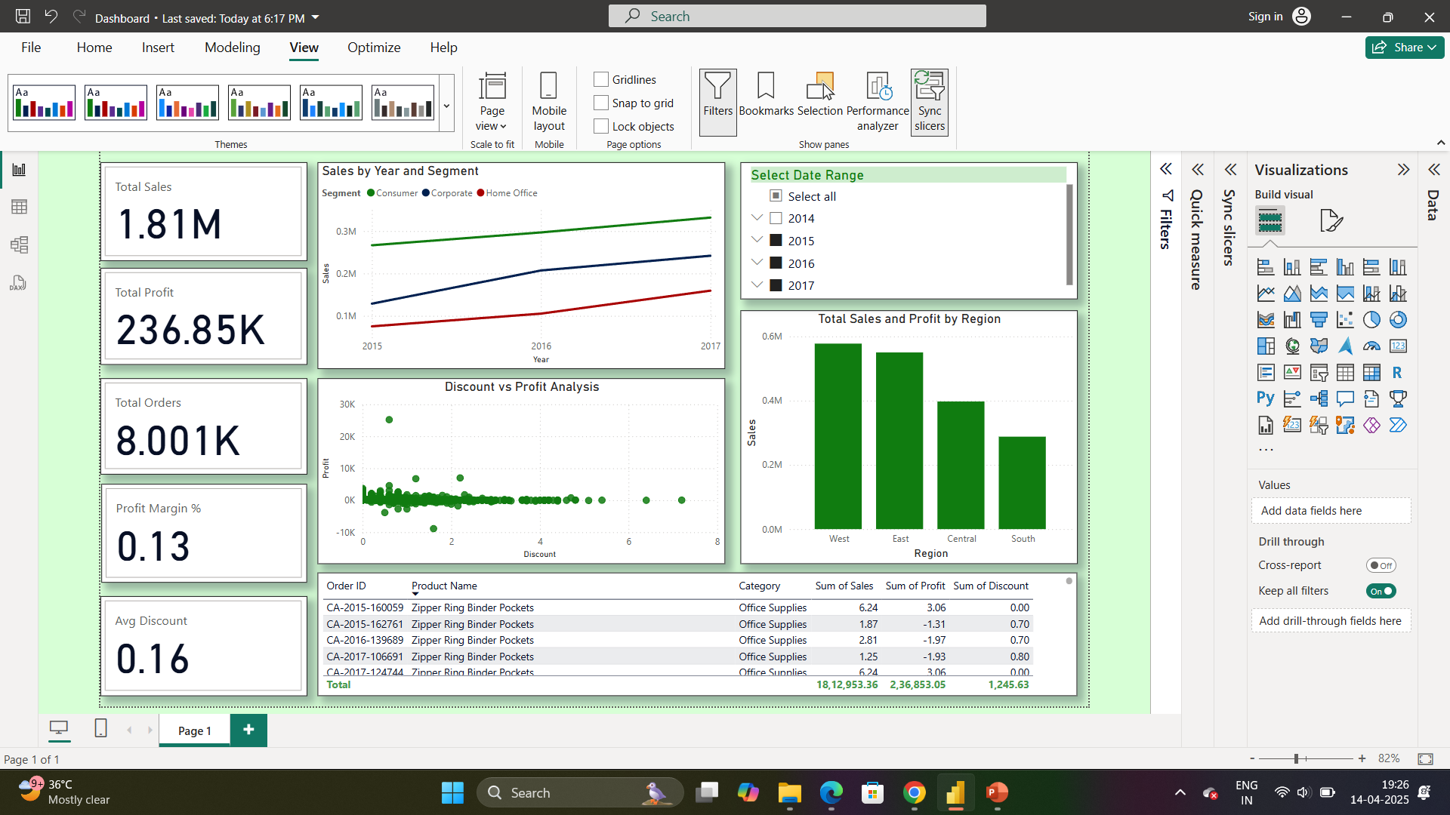
Insights from Visuals
Sales by Segment Over Time
Consumer segment shows steady growth
Regional Analysis
West has the highest sales and profit
Discount vs Profit
Higher discounts often lead to lower profits

Slide 5
Interactivity & Filters
Slicers Used:
Order Date
Category
Region
Segment
State
Enables real-time filtering and comparison

Slide 6
Sales Dashboard

Slide 7
Conclusion
The dashboard enables stakeholders to make data-driven decisions by identifying top-performing segments, regions, and the impact of discounts on profitability.

